Slide 1
PLANT PROPAGATION
HORTICULTURE
By RAHUL R
B.Com (General) – A
3940

Slide 2
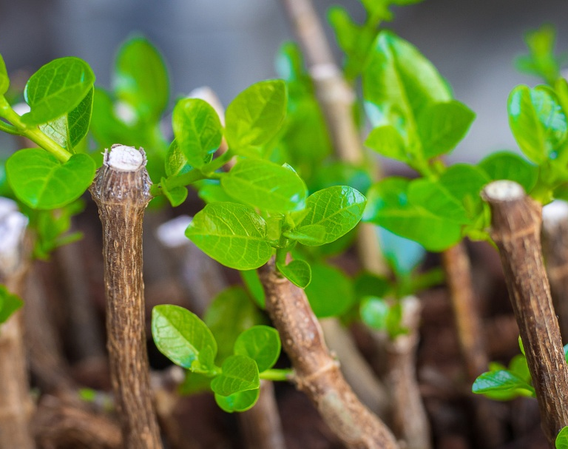
PLANT PROPAGATION
Plant propagation is the process of increasing the number of plants of a particular species or cultivar. There are two primary forms of plant propagation: sexual and asexual. In nature, propagation of plants most often involves sexual reproduction, or the production of viable seeds. When exposed to proper environmental conditions, these seeds germinate and grow into mature, reproductive plants. Over the years, horticulturists have also developed asexual propagation methods that use vegetative plant parts. This allows plants to be created in ways that nature cannot duplicate.

Slide 3
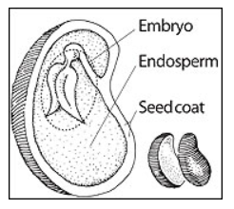
TYPES OF PLANT PROPAGATION
SEXUAL PROPAGATION
Sexual propagation uses seeds to produce new plants.
Sexual propagation is relatively easy and often requires no special equipment.
It is nature’s way to obtain many plants economically.
ASEXUAL PROPAGATION
Asexual plant propagation uses vegetative parts of the plant to make a clone, or an exact genetic copy, of the parent plant.
Gardeners use several general methods to propagate plants asexually such as:
Cuttings
Layering
Division
Grafting
Budding
Tissue cultures.

Slide 4
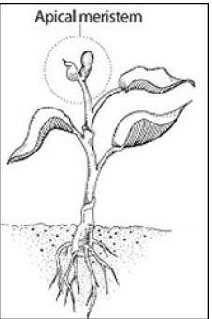
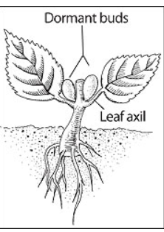
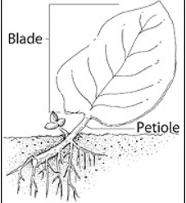
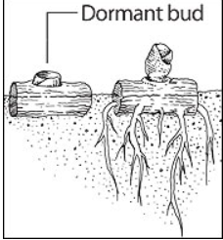
TYPES OF ASEXUAL PROPAGATION
CUTTING:-
Parts of plants removed from a parent plant and rooted to form new plants are called cuttings.
Cuttings can be classified according to the nature of the cutting material removed:
Leaf cutting
Stem tip cutting
Leaf and Bud cutting
Stem cutting

Slide 5
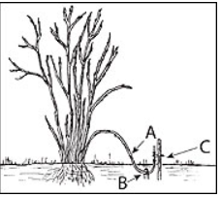
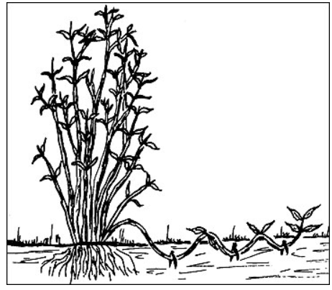
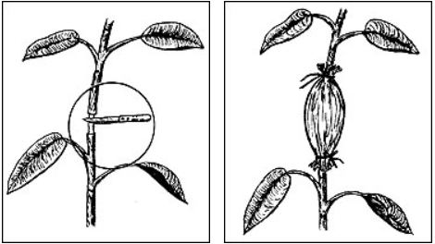
2. LAYERING:-
Layering is a method of propagating new plants when seeding, cutting, grafting and other methods are impractical or ineffective.
It consists of rooting a new plant while the stem is still attached to the parent plant. Because an entire branch of the parent plant is often needed to form a single new plant.
This method is useful for propagating only a few plants from each parent.
TYPES OF LAYERING:-
Simple layering
Compound layering
Air layering

Slide 6
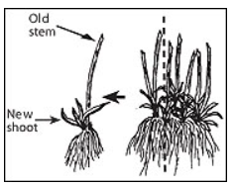
3. DIVISION:-
Crown division, or division, is one of the best ways to propagate herbaceous perennial plants.
For crown division, carefully lift plant clumps along with some soil removed from the roots.
The crown may then be cut into sections with a knife.
Individual growing points that contain roots may be used to form new plants.

Slide 7
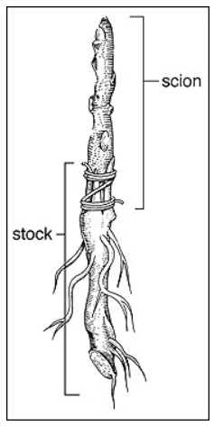
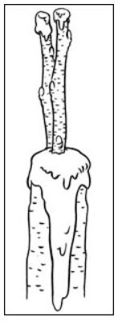
4. GRAFTING:-
Grafting is the act of joining two plants (or their parts) together.
The lower part of the graft is known as the understock, or stock, which becomes the root system or part of the trunk.
The upper part of the graft is known as the scion and becomes the top of the plant.
To make a successful graft, the cambium of the scion must line up as closely as possible with the cambium of the stock and make good, sustained contact.
STEPS IN GRAFTING:-
Prepare the stock and scion
Cutting the stock
Cutting the scion
Fitting the stock and scion
Protecting the graft

Slide 8
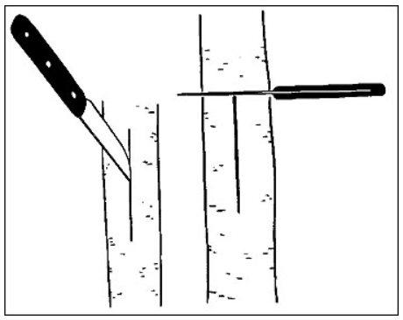
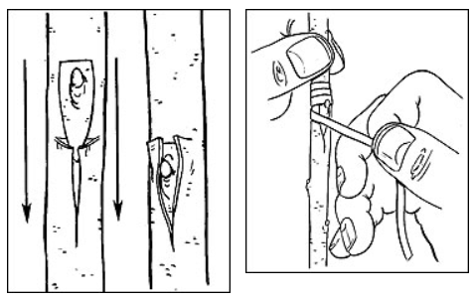
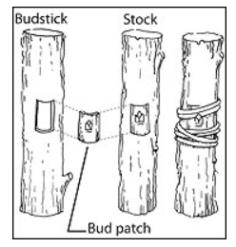
5. BUDDING:-
Budding is a method of grafting in which the scion is a single bud rather than a piece of stem.
It is most frequently used to multiply a variety that cannot be produced from seed.
It may also be used for top working trees that cannot be easily grafted with cleft or whip grafts.
T – Budding:-
Selecting the stock
Obtaining bud sticks
Preparing for stock
Inserting the bud
Caring for the bud
Patch Budding:-
Preparation for bud sticks
Removal of bud patch
Preparing for the stock
Wrapping the bud patch
Cutting back the stock

Slide 9
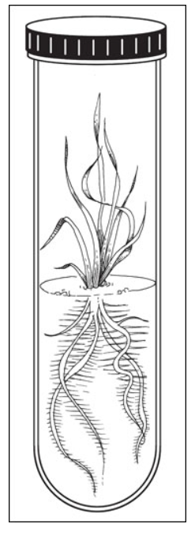
6. TISSUE CULTURE:-
Tissue culture, or micropropagation, is the art and science of propagating plants in vitro, which means "within the glass," in this case, a propagation tube.
Tissue culture techniques allow thousands of new plants to be obtained from a single plant, making the technology attractive to rapidly multiply new cultivars.
Its limitations include the need for specialized equipment and facilities along with a great deal of highly skilled labor.
The tissue culture process can be divided into four steps or stages: explanting, multiplication, organogenesis and acclimatization.

Slide 10

THANK YOU

